Slide 1
Scouts BSA
Position Specific Training
Prepared by :
Susie Kerr
Bushy Run District Training Chairman
Notes:
Scoutmasters/assistants: Prerequisite is Hazardous Weather Training

Slide 2
Positions
Covered
Merit Badge Counselor
Committee member
Committee Chairman
Scoutmaster
Assistant Scoutmaster
Notes:
Trainings build on one another.
Please feel free to ask questions

Slide 3
Mission of Scouting:
The mission of the Boy Scouts of America is to prepare young people to make ethical and moral choices over their lifetimes by instilling in them the values of the Scout Oath and Law.

Slide 4
Scout Oath & Scout Law
Scout Oath:
On my honor I will do my best
To do my duty to God and my country and to obey the Scout Law;
To help other people at all times;
To keep myself physically strong, mentally awake, and morally straight.
Scout Law:
A Scout is --
Trustworthy Obedient
Loyal Cheerful
Helpful Thrifty
Friendly Brave
Courteous Clean
Kind Reverent

Slide 5
Aims & Methods of Scouting
Aims:
Character Development
Citizenship Training
Personal Fitness
Leadership Development
Methods
Ideals Patrols
Outdoor Programs Advancements
Association with Adults Personal Growth
Leadership Development Uniform
Notes:
Let’s expand on the Methods of Scouting:

Slide 6
Methods of Scouting …
1) Ideals
Are spelled out in the Scout Oath, Law, Motto, and Slogan.
Motto: Be Prepared
Slogan: Do a good turn daily
2) Patrols
gives experience in group living
participating citizenship
responsibility
determine troop activities through elected representatives
Notes:
Reference the posters for the Oath & Law

Slide 7
Methods of Scouting … continued
3) Outdoor Programs
Scouting is designed to take place outdoors
- learn to share responsibilities
- learn to live with each other.
- skills and activities practiced at troop meetings come alive with
purpose.
- laboratory for Scouts to learn ecology and practice conservation of
nature’s resources.
4) Advancements
-provide a series of surmountable obstacles and steps to overcome them
- A Scout plans their advancement, and is rewarded for each achievement
gaining self-confidence.
- help scouts grow in self-reliance and the ability to help others.
Notes:
Outdoor programs:
Mention leave no trace

Slide 8
Methods of Scouting … continued
5) Association with Adults
Scouts learn from the example set by their adult leaders. An association with adults of high character is encouraged.
6) Personal Growth
As Scouts plan their activities and progress toward their goals, they experience personal growth.
The Good Turn concept is a major part of the personal growth method of Scouting.
Scouts grow as they participate in community service projects and do Good Turns for others.

Slide 9
Methods of Scouting … continued
7) Leadership Development
Learn and practice leadership skills.
Every Scout has the opportunity to participate in both shared and total leadership situations.
Understanding the concepts of leadership helps a scout accept the leadership roles of others and guides them toward the citizenship aim of Scouting.
8) Uniform
Visible force of good and creates a positive scout image in community
Shows commitment to the aims and purposes of scouting
Gives identity as part of the world brotherhood of scouting
Provides a way to wear awards showing their accomplishments
Notes:
Uniforms: full uniform standard is established by the chartered organization in conjunction with the SM and CC (key 3).

Slide 10
Introduction to merit badges

Slide 11
What is a Merit Badge Counselor…
An adult that is knowledgeable about the subject matter of the merit badge and willing to work with scouts to accomplish the requirements printed in the merit badge pamphlets
Requirements:
Completion of the Scouts BSA adult application
Completion of Youth Protection Training
Completion of clearances
PA State police clearance
Childline child abuse clearance
FBI clearance or waiver if residing in PA for 10 years
Criminal Background Check Authorization Form
Completion of Merit Badge worksheet listing badges you are qualified to counsel
Receive approval from the Council Advancement Committee
Clearance information can be found at www.wfbsa.org under the “Leaders” link
Notes:
Clearances and BSA application required for all Scouts BSA positions
5**Cit in the Society- must be approved, must take Diversity, Equity and Inclusion training and sign letter of affirmation
must be 4-8 scouts

Slide 12
What are
Merit Badges?
Merit badges are awards earned by youth members of Scouts BSA, based on activities within an area of study by completing a list of periodically updated requirements.
There are 135 Merit Badges available.
21 total Merit Badges are required for Eagle scout rank.
Beginning July 2022:
14 are specific Eagle required and 7 Scout’s choice.
Notes:
Merit badges can be a life skill, a hobby, a profession, fitness related, art, music, etc
Eagle badges have a silver/white ring.

Slide 13
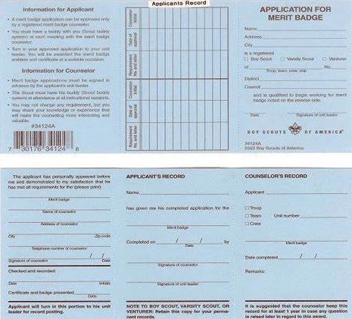
Merit Badges
Scouts can begin working on merit badges at any time.
Before meeting with the Merit Badge Counselor:
The scout must meet with the Scoutmaster to discuss their plans and to obtain the name of an approved MB counselor.
The scoutmaster will sign the Application for Merit Badge (blue card) and give it to the scout.
Notes:
*** important MB counselor to initial and note the requirements completed. MB cards should be completed in ink.

Slide 14
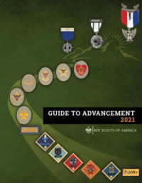
Merit Badges
After completion of the badge:
The Merit Badge Counselor signs the blue card in 2 places to indicate the badge is completed.
The scout returns the blue card to the Scoutmaster to discuss the experience and get the Scoutmaster’s signature.
The Scoutmaster signature only shows the unit leader is aware of the completion.
For Detailed explanation of how to use the Merit Badge Application, “blue card”, see the
Guide to Advancement section 7.0.0.2
Notes:
The scoutmaster discussion is not for the purpose of approving the merit badge- that was done by the counselor. Once it’s earned, it’s earned

Slide 15
Advancement
4 steps to Advancement
Scout learns
Scout is tested
Scout is reviewed
Scout is recognized
Notes:
Guide to Advancement: resource for all advancement related questions

Slide 16
A scout plans their own advancement and progresses at their own pace as each challenge is met
A scout is rewarded for their achievement which helps build self-confidence which is the goal of advancement
With increased confidence,the scout realizes they can learn new skills and disciplines.
Advancement gives the scout positive recognition and incentive for further participation in Scouts BSA
Therefore, advancement helps the Scout learn and grow

Slide 17
As Scouts complete advancements, they achieve the 4 aims of Scouting.
Character Development
Citizenship Training
Mental and Physical Fitness
Leadership Development
Goal of Advancement… Achieve the 4 aims of Scouting

Slide 18
Advancement is not an end in and of itself:
One of several methods designed to help unit leadership achieve the Aims and Mission of Scouting BSA
Notes:
Troops with a strong outdoor program will naturally have a strong advancement program., and statistics show that strong advancement leads to increased satisfaction and retention of scouts

Slide 19
Advancement supports
National Council sets and maintains quality standards in all advancement requirements
Council Advancement Chair recruits and trains the council advancement committee which stimulates advancement in the council
District Committee advancement chair recruits and trains the district committee and ensures there is a solid advancement plan for the youth members
Unit Advancement Coordinator is a member of the troop committee and responsible for supporting the unit advancement program including advancement records, arrange Boards of Review (BOR), and quarterly Courts of Honor (COH) to publicly recognize scouts for their accomplishments
Notes:
WFBSA council Advancement Chair:

Slide 20
Advancements and the Scoutmaster
Key part of scoutmaster’s role is to lead youth to plan a program rich in advancement opportunities.
Advancement is a natural outcome of the unit’s activities, not a goal in and of itself
Scoutmasters select and approve who can sign off advancements
Once a scout is tested and signed off by someone approved by the scoutmaster, the requirement has been met.
Signing off the requirement isn’t the end, the unit program should provide practical opportunities for the scout to use the skills building retention through repeated use of the skills

Slide 21
The Scoutmaster approves service hours
Service hours for ranks, other than Eagle, only require participation. Planning, development or leadership is not required.
Pre-approval of Eagle Scout service projects is important because it calls on youth to think about what might be accepted and to be prepared to discuss it.
Scoutmaster & Service hours
Notes:
For questions regarding approval of service hours: Guide to Advancement 4.2.3.3.

Slide 22
Positions of Responsibility
The unit should have clearly established expectations for positions of responsibility
The Scoutmaster is to provide coaching on positions of responsibility
If the position of responsibility expectations are not being met, it is the Scoutmaster’s responsibility to address the situation
For explanation of how coaching for positions of responsibility works, please see the Guide to Advancement 4.2.3.4
Notes:
Guide to Advancement 4.2.3.4
Scoutmaster is a hands on leader.
Committee is supportive to the troop

Slide 23
Scoutmaster Conference
Purpose:
Gauge the health of the troop and ensure the scout is succeeding
Intended to be a rewarding experience for Scoutmaster and Scout, helping the Scout to grow in Scouting.
Not a test, it’s a conversation, and a scout is only required to participate in order to proceed to a Board of Review
Scoutmaster may delegate a scoutmaster conference to Assistant Scoutmasters
A Scoutmaster conference generally proceeds the Board of Review, but more than one Scoutmaster conference may occur along the way and any one of them may count toward the requirement.
Notes:
Guide to advancement section 4.2.3.5

Slide 24
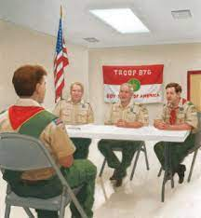
Boards of review
The BOR is a chance for adult committee members to speak with the Scout about what they have done, what has been learned & how it has helped them in their advancement and how they are enjoying the program.
It’s an essential part of the Scouts BSA experience and required for every rank from Tenderfoot to Eagle Scout.
It is not a test, but scouts can fail a board of review.
If a Scout fails his Board of Review, that Scout can re-test with the Board after 3 or 6 months (depending on rank) of active participation in Troop and Patrol activities.
Notes:
Lots of Online resources for BOR questions

Slide 25
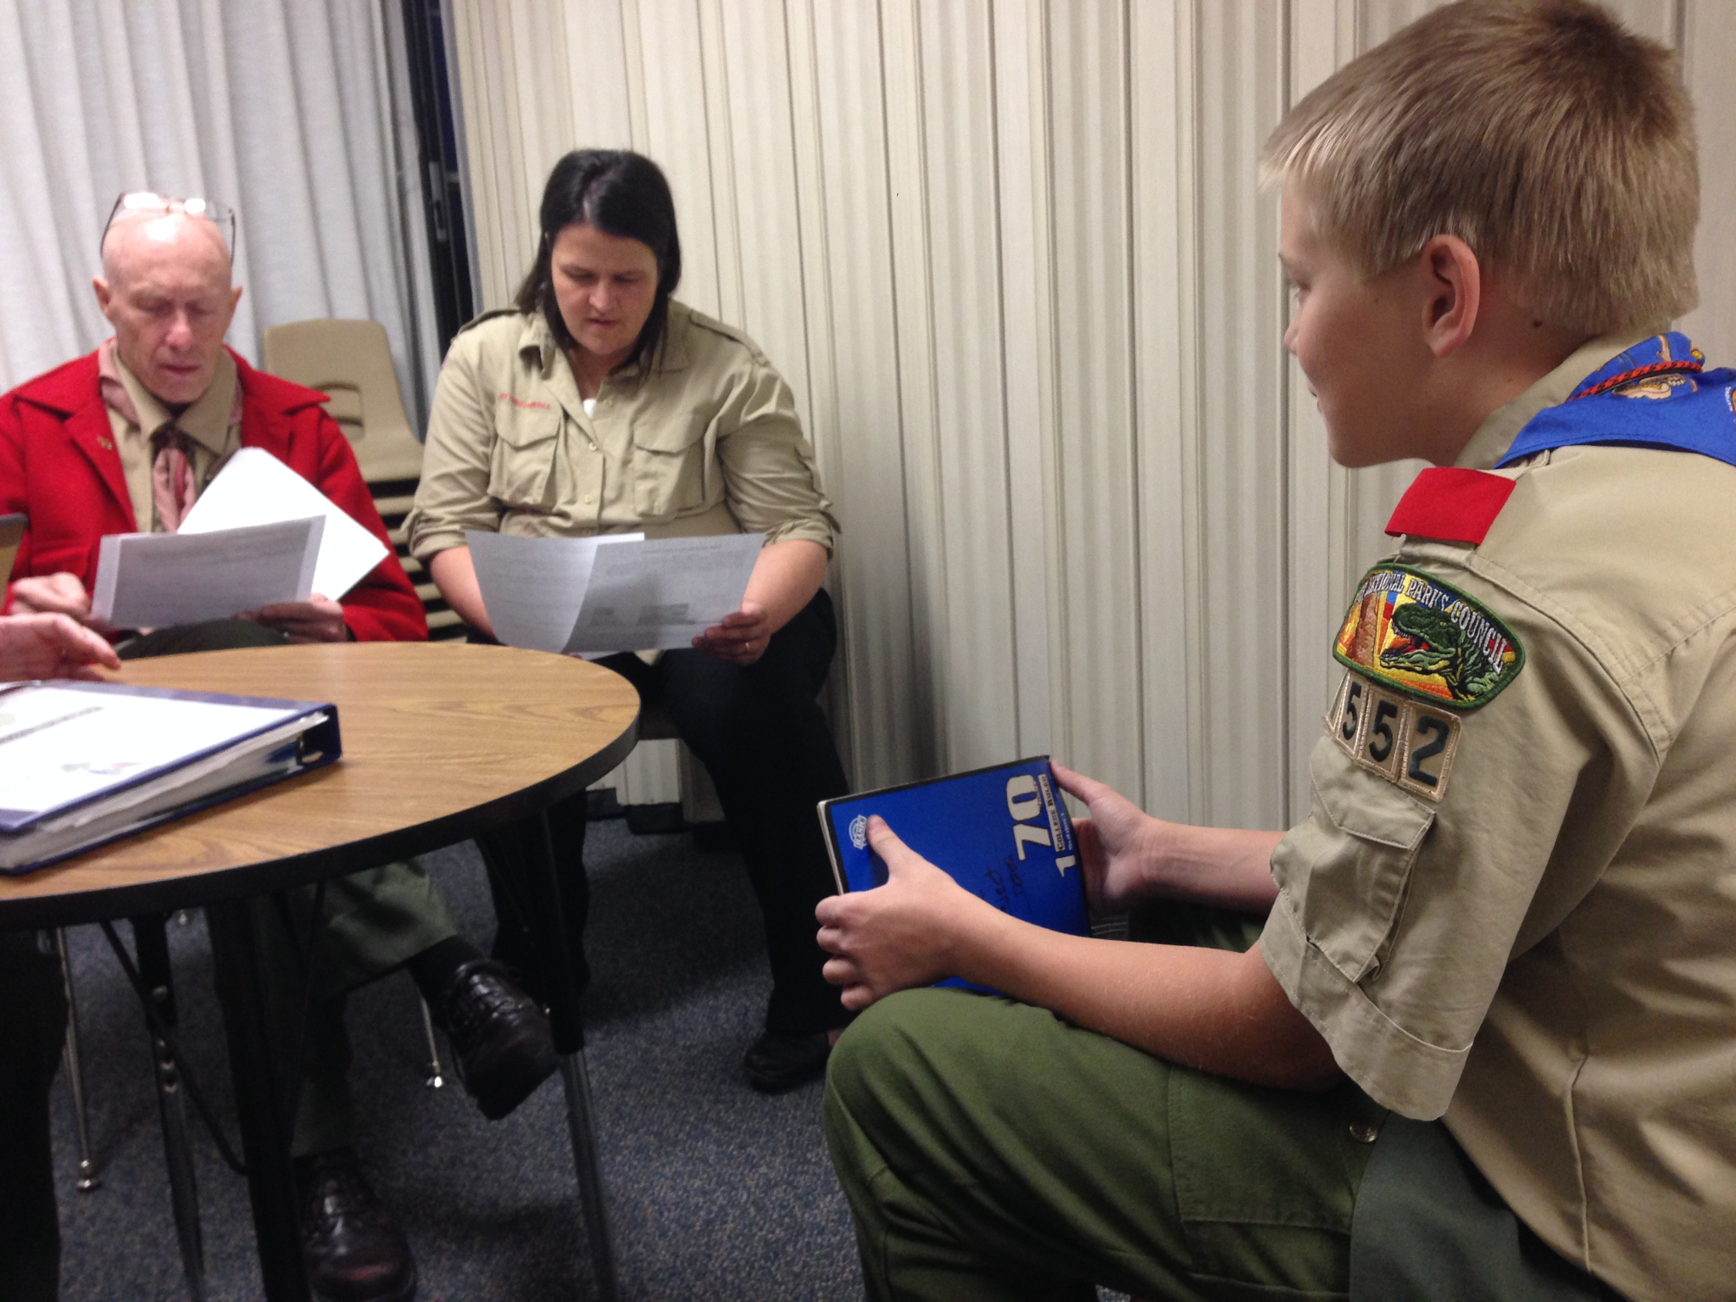
Boards of review… continued.
When a Scout believes that all the requirements for a rank have been completed, including a Scoutmaster conference, a board of review must be granted
A board of review can not be denied or postponed due to issues such as uniforming, payment of dues, participation in fundraising activities, etc.
The Unit Leader, Scoutmaster, may be present, but the BOR can ask them to leave.
Parents should not be present and can not serve on their own child’s BOR.
A BOR must consist of no fewer than 3 members and no more than 6, committee members all of whom must be at least 21 years of age.
Notes:
For small units: it is permissible to use knowledgeable parents (not those of the candidate) or other adults (registered or not) who are at least 21 years of age and who understand Scouting’s aims. Using unregistered adults for boards of review must be the exception, not the rule.
Registered committee members familiar with the unit program, who have had a background check, and who are Youth Protection trained are preferred.

Slide 26
For All Advancement questions:
Most current copy can be found online at:
https://filestore.scouting.org/filestore/pdf/33088.pdf
BSA rank requirements ; some have updates for 2023.
https://www.scouting.org/wp-content/uploads/2022/10/2023-Scouts-BSA-Rank-requirements.pdf

Slide 27
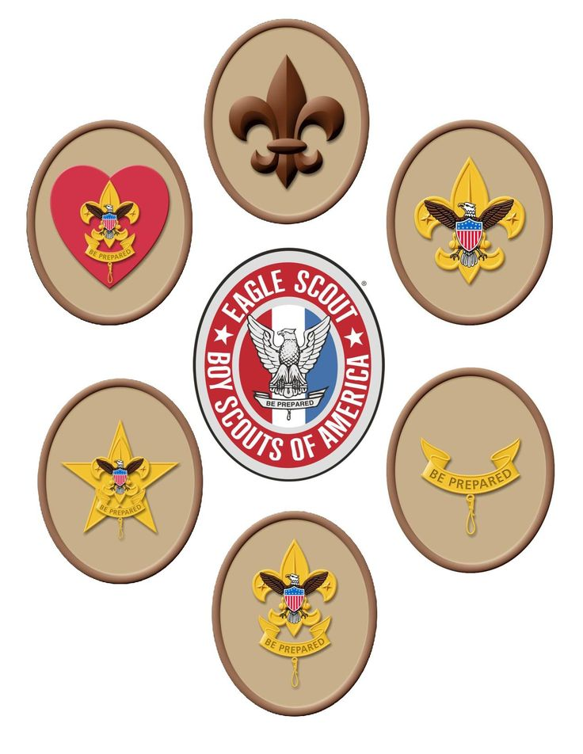
Advancement summary
Advancement is not an end in itself, but one of several methods designed to help unit leaders achieve the Aims and Mission of Scouts BSA

Slide 28
Congratulations!
This concludes the Merit Badge Counselor portion of Training.

Slide 29
Committee Chairman
&
Committee Member

Slide 30
Scouting Organization
Scout
Patrol
Troop
Troop Committee/ Key 3
Chartered Organization
District
Local Council
Area
Region
National Council
Notes:
SCO_481

Slide 31
Scout: Must be at least 10 years old and currently in 5th grade and register on or after March 1st; OR 10 years old and earned Arrow of Light (AOL); OR 11 years old but not yet 18
Patrol: Group of 5-8 Scouts that elects its own leader (Patrol leader).
The Patrol Leader (PL) guides the members of their patrol and represents them at the Patrol Leaders conference and annual programming conference.
Troop: Group of patrols led by the Senior Patrol Leader (SPL)
Troops are run by their Youth leadership with
guidance from the Scoutmaster.
Scout Patrol Troop
Notes:
Patrols:
Assistant Patrol leaders- fill in for PL in their absence
PLC- voting members: SPL, ASPL, PL, troop guide, . It is the PLC that, not adult leaders, that is responsible for planning and conduction troop activities. The scoutmaster/assistants support the PLC in their endeavors.
Several types of patrols
New Scout- newly joined members work together 1st year
Regular Scout- completed 1st class (BSA Guide to Advancement recommends 1st class by 1 year)
Older Scout- 13+ years old who want more challenging high adventure experience

Slide 32
Troop: a group of patrols. Troops are run by youth leaders with
Guidance from the Scoutmaster.
Troop Leadership Positions:
Senior Patrol Leader (SPL) Jr. Assistant Scoutmaster
Assistant Senior Patrol Leader (ASPL) Den Chiefs/ Webelos Den Chief
Patrol Leaders (PL) Scribe
Troop Guide Quartermaster
Historian Bugler
Librarian Webmaster
Instructor Outdoor Ethics Guide
Chaplains Aide Troop OA representative
Notes:
SPL- Leads patrol leaders and in consultation with Scoutmaster approves other scout youth leaders and assigns specific responsibilities.
ASPL- fills in for SPL in their absence. Responsible for training and giving leadership to the other leadership roles. Large troops may have more than 1 and they may have a specific area assigned to them (ASPL for training, ASPL for program, etc)
Guide- advisor/mentor to a new scout patrol
Historian- collect and maintain troop memorabilia and information on former members
Librarian- keeps books, pamphlets, magazines. MB books to become all online soon
Instructors- teach one or more advancement skills to troop members
Chaplain Aide- assists troop religious services and promotes religious emblem program to scouts
Jr. Assistant Scoutmaster- Only position appointed by SM. must be16 years or older supervises and supports other youth leaders as assigned. At 18 yrs old can become ASM.
Patrol Leaders- elected by their patrol members
Den Chief/ Webelos Den Chief- work with cub scout dens and webelos dens as a guide
Quartermaster- responsible for troop supplies and equipment
Scribe- troop secretary
Webmaster- maintains troop website
Outdoor Ethics Guide- teaches Leave No Trace principals and Tread lightly guidelines and ensures troop practices on outings.
Troop OA Representative- link between troop and Lodge, promotes OA, camping, and high adventure programs to troop.
Bugler- plays bugle at troop ceremonies and marks key moments during the day on troop outings

Slide 33
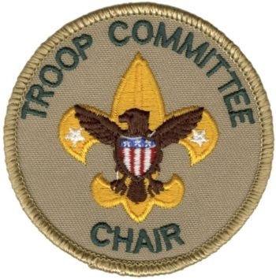
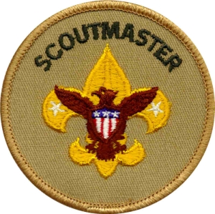
Troop Committee: Board of Directors for a Troop that are selected by the
Chartered Organization .
The Key 3: Chartered Organization Representative, Troop Committee Chair,
and Scoutmaster.
Chartered Organization: Community organization that
supports the mission statement
of the BSA. “owns the Troop.”
Troop Committee/ Key 3 & Chartered Organization
Notes:
Troop Committee: Board of Directors for a Troop that are selected by the Chartered Organization to support the Scoutmaster and Assistant Scoutmasters by helping with the administrative functions ( ie: finances, transportation, advancement record keeping.)
The Key 3 make recommendations to the Troop Committee to strengthen the unit service to youth. The Key 3 discuss challenges, progress to JTE
CO: selects & approves all adult leaders and provides a safe meeting place. It encourages outdoor experiences

Slide 34
District:
Organizes and Supports units.
Comprised of a committee and Key 3
Westmoreland - Fayette Council Districts
Key 3
District Executive: (Scouting Professional)
Paul Rock- Bushy Run
Hugh Hubble- Laurel Hill
Kristen Eagle- Old Trails
District Chairman: Volunteer
District Commissioner: Volunteer
The district has a committee that supports scouting. It supports programming, membership, and training.
Notes:
Same structure as a troop. Key 3
Committee is made up of volunteers from across our district. We have openings on the district committee and our commissioner volunteers. If you would be interested in joining, please see me

Slide 35
Local Council
Westmoreland-Fayette Council
Key 3
Scout Executive: Marcus Ragland
(Scouting Professional)
Council President: Mike Blasco
(volunteer)
Council Commissioner: Sara Bednarofsky
(volunteer)
Is a not for profit organization chartered by the BSA National Council to provide Scouting programs to local youth.
Notes:
Provides valuable information and guidance to the scouting program. Just like units, it is led by a key 3 and executive board
Runs programs and camps, assists with forming units and coordinates the FOS campaign

Slide 36
Territories
Supports councils through a collaborative network under leadership of a Key 3 and functional leads focussing on council operations and delivery of the Scouting Program.
Westmoreland-Fayette Council is in
National Service Territory 12.
Notes:
16 Territories includes Eastern Europe (including Africa & Middle East) and North America.

Slide 37
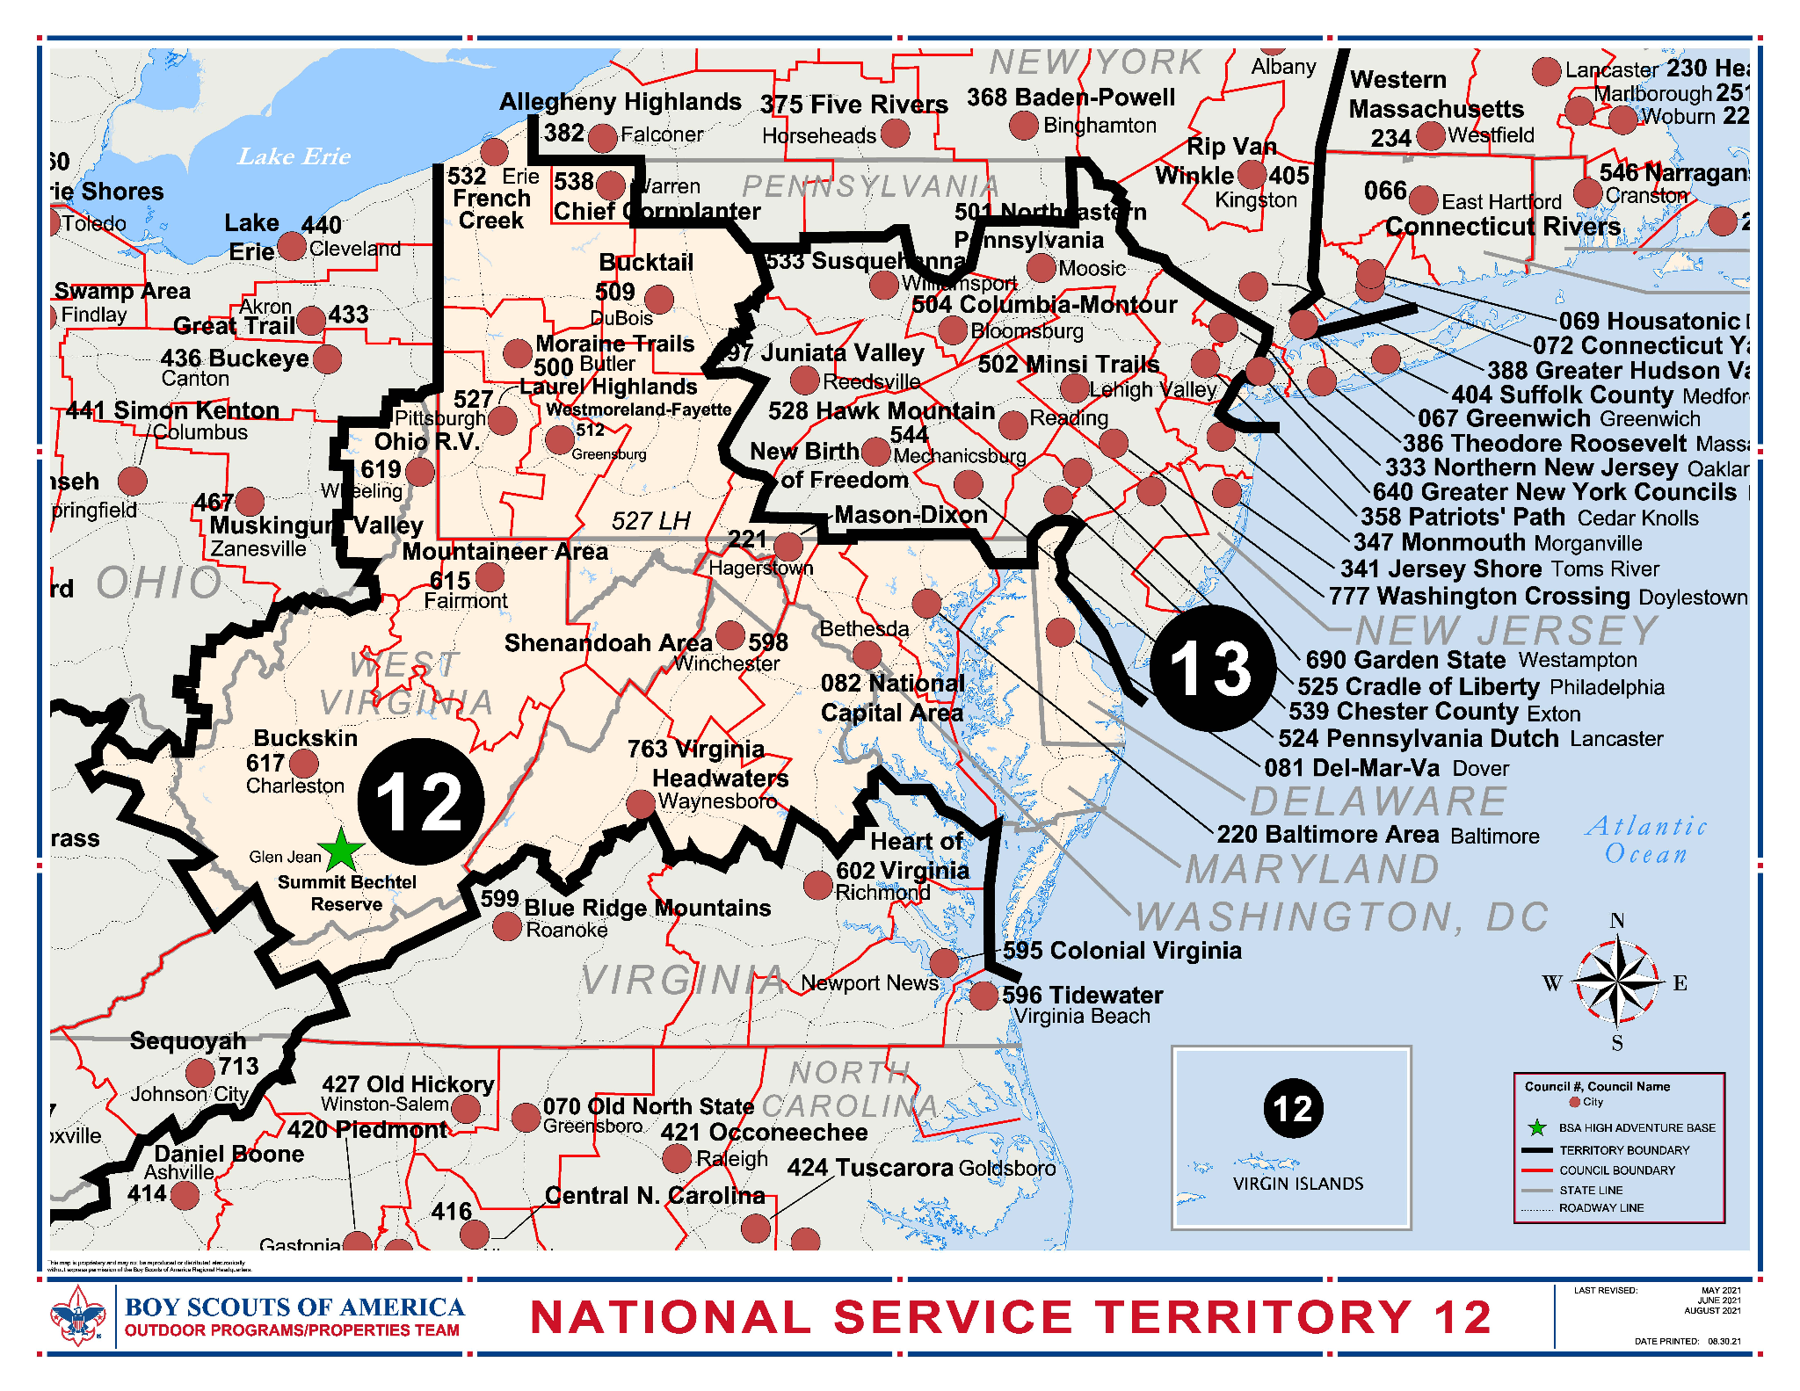
National
Service
Territory 12
(NST 12)
Notes:
SCO_479
Key 3 = SM, CC and COR

Slide 38
National Council
Led by the National Executive Board, a volunteer Board of Directors.
Administers the overarching Scouting Program
Sets and maintains quality standards in training, leadership selection, uniforming, registration, records, literature development, and advancement requirements.
Administration is performed by paid employees out of the National Service Center.

Slide 39
Role of Key 3:
Ensure that the scouting members get the best possible experience
Recommended to meet once a month:
Discuss unit, challenges, coming events, and goals in order to make recommendations to the unit committee to develop and deliver a quality program.
Journey to Excellence goals are an excellent metric for your planning.
Chartered Organization Representative
Scoutmaster
Committee Chair
Notes:
SCO_479
Key 3 = SM, CC and COR

Slide 40
Chartered Organization Representative
Appointed by head of Chartered organization (CO) and is the direct contact between the unit and the CO.
Appoints the Committee Chairman of the unit and approves all leaders of the unit.
Promotes program and outdoor program
Approves finance policies of the unit
Helps Committee Chair develop leaders and may attend unit committee meetings
Encourages training and recognition
Helps with charter renewal
Suggests “good turns” such as service projects for the Charter Organization.

Slide 41
Committee Chairman
Appointed by Chartered Organization Representative
Advises and supports unit leaders
Works closely with Scoutmaster and Chartered Organization Representative
Recruits and develops committee members
Ensures all functions are delegated, coordinated, and completed.
Supervises committee members
Develops the agenda for monthly meetings
Presides over and promotes committee meetings
Provides ample training opportunities
Interprets national and local policies for the unit
Ensures a representative for monthly roundtable
Completes charter renewal

Slide 42
Scoutmaster
Appointed by Chartered Organization Representative
Direct contact leader with Scouts
Advises SPL, directs, coaches and supports SPL in leading the troop
Coaches and supports Patrol Leaders Council (PLC)
Makes sure program is conducted in accordance with National BSA policies
Keeps everyone safe by following Safe Guide to Scouting
Liaison with Parents
Attends outings and committee meetings
Assists with recruitment of Assistant Scoutmaster, supporting and encouraging training
Completes Scoutmaster conferences. May delegate conferences to Assistant Scoutmasters

Slide 43
What’s required for a troop?
Chartered Organization/ Chartered Organization Representative
Committee Chair
Minimum of 2 Committee Members (addition to Chair)
Scoutmaster

Slide 44
Troop Committee
Is the Board of Directors for the troop and is the troop support system.
Minimum of 3 members needed: Committee Chair plus 2 other members
No Maximum number of members
Notes:
SCO_482
Members must be 21 yrs or older. Committee is an excellent way to involve parents, especially those who prefer not to camp or those with limited time. COR may dual register as Committee Chair or committee member
Relationship between the committee and the scoutmaster should be friendly and trustful. Scoutmaster should be able to turn to committee for assistance, dealing with difficult situations, support, and encouragement
Committee is there to support scoutmaster in helping to make the Troop a success.

Slide 45
What does the committee do?
Supports the Scoutmaster in delivering a quality program
Recruits & trains committee members
Replaces Scoutmaster when absent or in the event they are unable to serve
Handles troop administration & responsible for finances, adequate funding & disbursement in line with the approved budget
Obtain, maintain, and properly care for troop equipment
Ensures outdoor program with minimum of 10 days & nights per year spent in the outdoors
Members serve on Boards of Review, plan and support Courts of Honor
Provides for special needs & assistance that some youth may require (Diversity, Equity, Inclusion)
Handles charter renewal, advancement, and ensures all adults have current Youth Protection Training
Notes:
Encourage completion of DEI training

Slide 46
Roles within the committee…
Secretary
Treasurer
Fundraising Coordinator
Advancement Coordinator
Chaplain
Religious emblem Coordinator
Equipment Coordinator
New member Coordinator
Membership Coordinator
FOS Coordinator
Outdoor Activity Coordinator
Training Coordinator
Informal members
Notes:
Secretary: keeps minutes of meetings and record. Sends communications, handle publicity, prepares family newsletter, conducts troop resource survey. Collects and organizes health forms and insurance.
Treasurer: supervised by committee chair. Keeps financial records, supervises Scribe and FOS coordinator. Leads preparations of annual troop budget. Follows BSA guidelines for fundraising.
Fundraising Coordinator: often done by treasurer. Supervises all fundraisers & ensures all youth have opportunity to participate. Responsible for all council related fundraisers (popcorn kernel)
Advancement Coordinator: supports Scoutmaster vision for advancement. Stimulates Advancement program. Works with Scribe to maintain advancement records. Reports advancements to local council. Arranges BOR and Courts of HOnor. Works with troop librarian to build & maintain troop library
Chaplain: gives guidance to Chaplain’s Aide. provides spiritual tone for troop. Promotes regular participation of each member in the activities of their religious organization of their choice. Promotes religious emblem program
Religious Emblem Coordinator: acquaint scouts with emblems.update on council religious activities. Work with district /council religious coordinators.
Equipment Coordinator: works with quartermaster. Responsible for the inventory, storage, and maintenance of troop equipment. Encourages safe use of all outdoor equipment
New member Coordinator: welcome new scout parents, provides orientation to the troop, updates parents on troop program & child’s involvement, recruits parent to help with a specific assignment ro project. Encourages parents to register as leaders and take YPT.
Membership Coordinator: develops plan for year round membership flow. Works closely with cub leaders to promote smooth transition. Encourages scouts to invite friends. Keeps track of drop outs and develops plan to encourage return.
FOS Coordinator: often done by treasurer. Develop FOS goal and conduct campaign. Enroll family members & adult leaders in campaign. Give recognition to contributors and enrollees.
Outdoor Activity Coordinator: obtains permission to use camping facilities or other sites. Coordinates transportation. Ensures monthly outdoor program. Works with secretary to assemble medical and insurance binder.
Training Coordinator: ensures opportunities for training for all youth and adult leaders. Maintains training records and inventory of training materials. Makers sure BSA youth protection is current. (also suggest keep dates of clearances)
Informal members: Scoutmaster and Assistant Scoutmasters are not formal members. Scoutmaster communicates scouts plans and needs. Serves as advisor.

Slide 47
Keep in mind…..
Don’t let size be an obstacle.
Divide tasks among the members
The Committee takes care of troop supportive functions to enable the Scoutmaster to focus on the Scouts
The Committee advises the Scoutmaster on policies of BSA and Charter Organization.
Available resources:
Troop Committee GuideBook
Troop Leader Guide Vols 1 & 2
Notes:
Troop Committee Guidebook: main source of information for committees
Troop Leader Guides: explain responsibilities of troop committees

Slide 48
The committee meeting:
Meetings should be held monthly and be no longer than 1.5 hours.
Purpose is to plan troop assistance, solve troop personnel problems and monitor troop progress
Committee members and the Scoutmaster report on status of troop, handle old and new business, and make announcements.
Active troops require participation of every committee member. Every member should have a working assignment.
The Chartered Organization Representative (COR) and Unit Commissioner may attend as needed.
Committee chair is responsible to call the meeting to order and close meeting as well as to keep the meeting moving.
Notes:
Members should feel important and needed- reason every member should have an assignment.
Poor attendance can be a result of- too little accomplished, meetings too long, member feels they are not important or needed

Slide 49
Sample Agenda
Troop 111 Committee Meeting
January 1, 2023
I) Call to order/Welcome
Take Attendance
ll) Review & approval of minutes
lll) Reports of Committees
a) Scoutmaster
b) Secretary
c) Outdoor Activities Coordinator
d) Treasurer
e) Advancement Coordinator
f) Chaplain
g) Training Coordinator
h) Equipment Coordinator
lV) Old Business
V) New Business
Vl) Announcements
Vll) Adjournment
Notes:
Minutes of the meeting are the official record of all business transacted during the meeting and represent what was actually done.
Secretary reads the minutes from the previous meeting if they weren’t sent out beforehand.
Reports of committees should be brief only be 2-3 minutes
Old business: update on tasks previously assigned
New business: assign tasks and taking votes on new issues
Announcements: any upcoming items. Announcements should include the date/time/location of the next committee meeting
Adjournment. By Committee Chair

Slide 50
Outdoor Program
Objectives of Outdoor Program:
Explain Outdoor Experience
Clarify Reasons why a strong outdoor program is vital
List 6 key parts in planning an outdoor program
Describe the Scoutmaster responsibilities
Identify additional resources
Is a vital part of Scouting and a method of Scouting
It’s an opportunity for Scouts to acquire skills to make them more self reliant and explore skills they thought were beyond their reach
Notes:
sco_ 476

Slide 51
The Outdoor Program…
Isn’t just camping.
It builds character, develops initiative, and promotes physical & moral development.
It’s a laboratory for life.

Slide 52
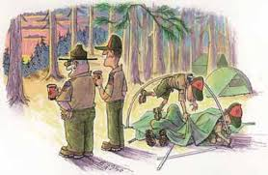
A strong outdoor program is vital.
Nature is a classroom without walls and is ideal for teaching and learning Scouting skills and relationship skills
It creates moments of positive influence in a Scout’s life.
It gives opportunities to make real life teams and provides leadership tests.
Scouts learn to respect each other’s opinions and share responsibilities.
It develops lasting friendship.

Slide 53
6 Key parts in planning an outdoor program
Establishing a purpose
Using the Patrol Method
Taking care of physical arrangements
Selecting site
Building a program of activities
Youth protection guidelines

Slide 54
Establishing a purpose
Where are you going and how are you getting there?
The outdoor program reinforces the 4 aims of scouting
Character development
Citizenship training
Personal fitness
Leadership development
Can be coordinated with the theme based on the monthly feature
Opportunity to promote Patrol method and put leadership skills into action

Slide 55
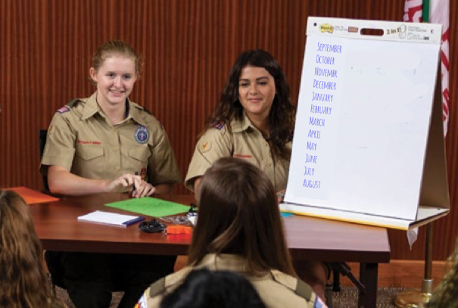
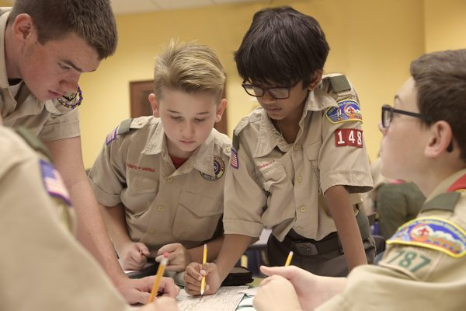
2. Using the Patrol Method
The Patrol Method is the ONLY way to run a successful Scout led troop.
The Patrol Method enables Scouts to develop into young leaders.
It teaches them how to cooperate and work together, learning from each other.

Slide 56
3. Taking care of physical arrangements
Scouts should have all the appropriate tasks necessary for the chosen activities.
This can include:
Assembling & preparing required equipment
Setting menus
Gathering food
Planning transportation
Assuring enough adult leadership help
Confirming activity is part of troop program plan
If payment or entrance fee is required, scouts should be ready with payment
Medical and insurance forms are collected

Slide 57
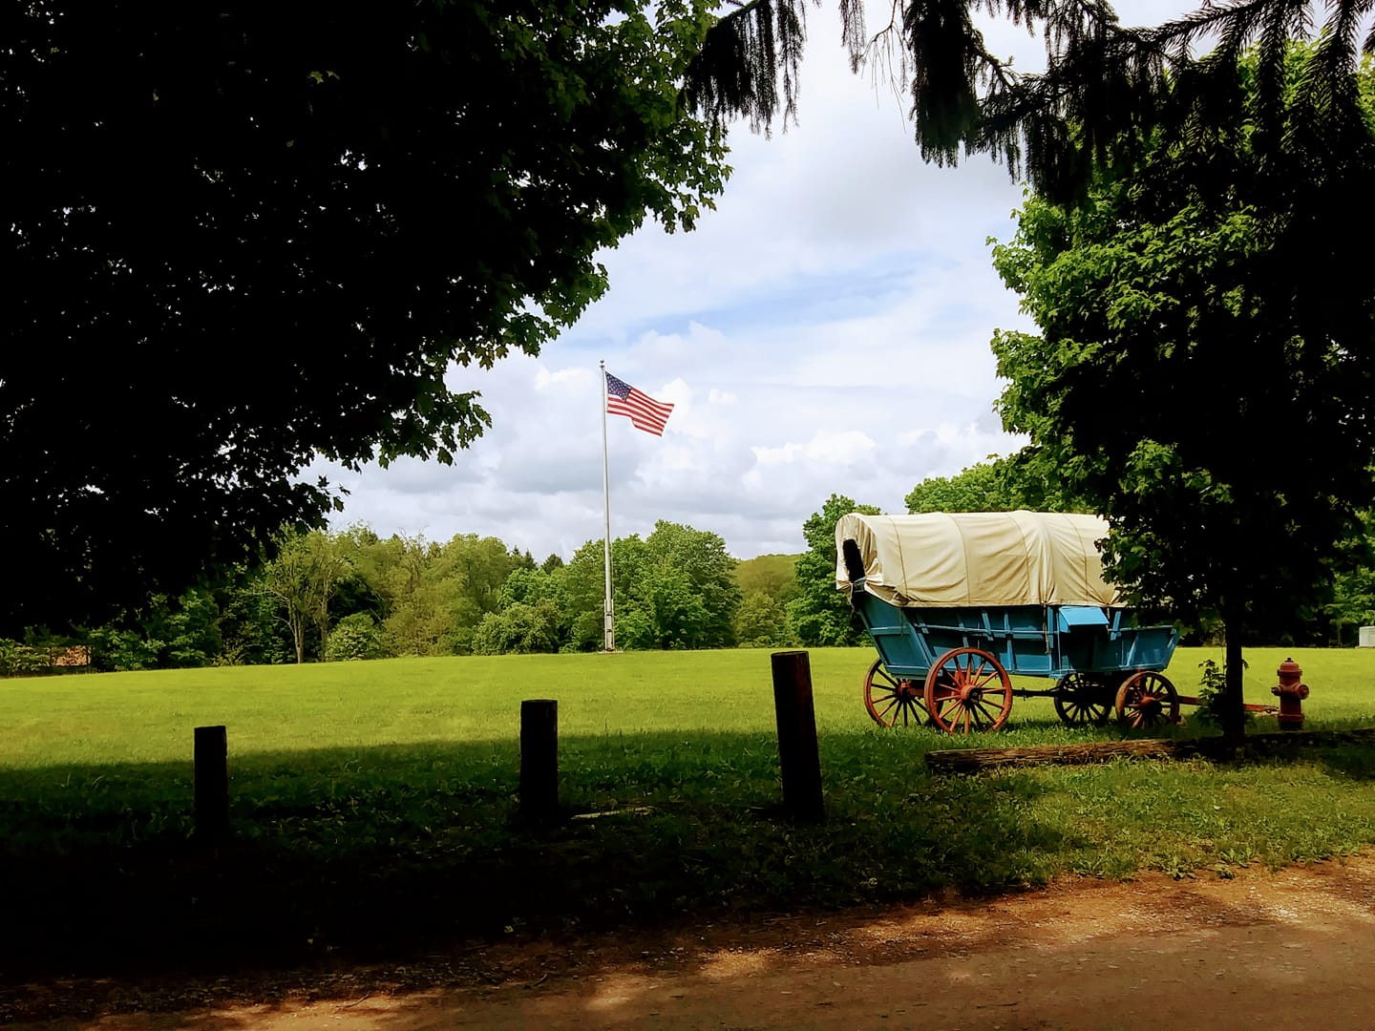
4. Selecting a site
Location selection can be local council properties; National, State, and Local parks & forests; local community parks
After site location is selected- contact the ownership or manager in advance to make sure of availability and regulations.
Each scout should be informed, understand, and adhere to rules & regulations.
All scouts should protect natural resources by adhering to guidelines and principles of outdoor ethics.
Notes:
Not all outdoor activities involve camping

Slide 58
5. Building a program of activities
Outdoor activities can include:
Nature & Advancement skills
Exploration
Tracking & Compass challenges
Environmental awareness
Cooking specialties
Star hikes
Conservation Good Turns
The Scoutmaster should help the Patrol Leaders Council plan and develop out scouting activities
Always stress safety and always use the Patrol Method.

Slide 59
6. Youth Protection Guidelines
Youth Protection should be adhered to on every camping outing.
Youth Protection renewal every 2 years and stay current on BSA policies & guidelines.
*** The most important responsibility as an adult leader is ensuring safety of your troop members

Slide 60
Scoutmaster Responsibilities
The Scoutmaster does play a key role in success
Lead by example
Ensure the 6 steps of outdoor planning are followed
Confirm the troop has a monthly outdoor activity
Make certain a long term camping experience or high adventure activity is planned once a year
The Scoutmaster should
stand back and let the scouts run the outdoor program

Slide 61
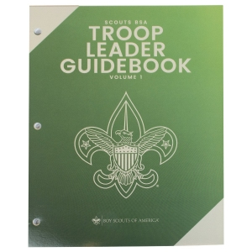
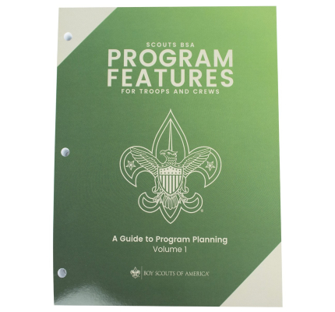
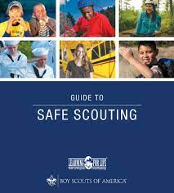
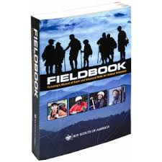
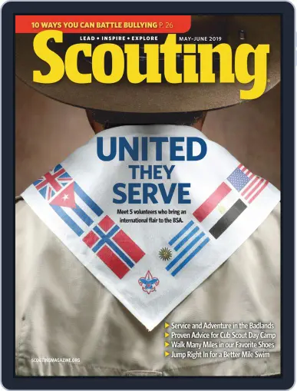
Additional Resources
Vols 1&2
Vols 1,2&3
Scoutmaster Position Specific Training (S24)
Leave No Trace
Tread Lightly!
Notes:
Troop Leader Guidebook- 2 volumes. Comprehensive Scoutmaster guide. Entire chapter devoted to ins and outs of planning effective outdoor programs, including checklists, gear lists, and other vital info
Scoutmaster specific training- basic leader training for the position, classroom based portion.
IOLS- introduction to outdoor leader skills- hands on scoutmaster training teaching outdoor skills used in scouting from Tenderfoot-1st class
Woodbadge- training program focuses on teaching adult scout volunteers leadership nd communication skills to help them serve successfully in their roles. Offered by local council
BSA Handbook- emphasixes leave no trace and Tread Lightly! Principals
Program Features for troops and Crews- 3 volume series of program plans
Guide to safe scouting- all current policies and procedures for conduction safe scouting activities. (online is most current version)
Fieldbook- reference for intermediate and advanced outdoor skills
Scouting magazine- filled with ideas for activities and themes. Contains the latest scouting info. Available on line and in an app

Slide 62
Outdoor adventure is a promise made to youth when joining scouting
The way scouts learn to do skills is to do it themselves on a troop activity.
(EDGE method)
Learning by doing is the hallmark of outdoor education.
Notes:
EDGE- Explain Demonstrate Guide Enable

Slide 63
Uniforms
Expresses friendliness to all other scouts
Represents a spirit of equality and democracy
Identifies fellow scouts
Symbolizes Character Development, Citizenship Training, and Leader Development
Wearing promotes comradery, a sense of belonging and public recognition of one’s membership in Scouting
For youth, it promotes pride in one’s patrol and troop
Notes:
sco_485

Slide 64
Official uniforms are authorized by the National Executive Board
The chartered organization may decide what is considered full uniform for their units, but cannot make alterations or additions without permission from the National Executive Board.
Scouts are not required to have a uniform in order to be a member, but it is encouraged.

Slide 65
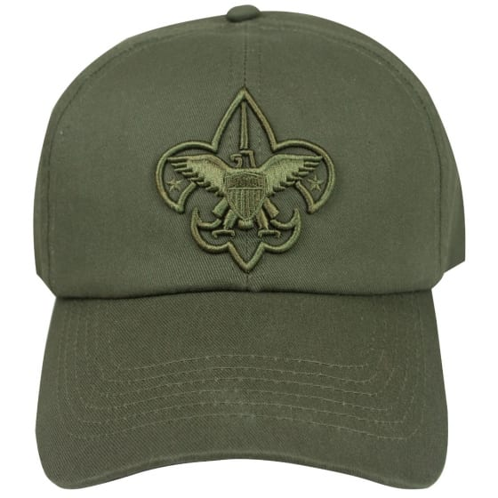
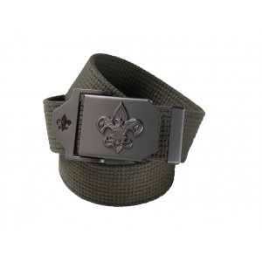
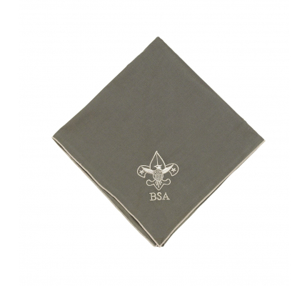
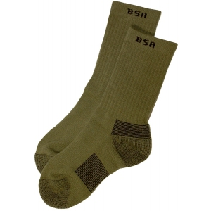
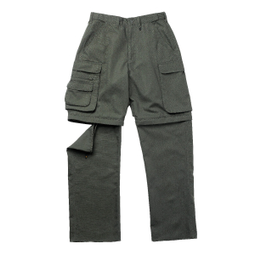
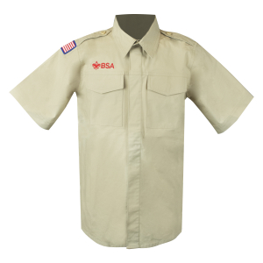
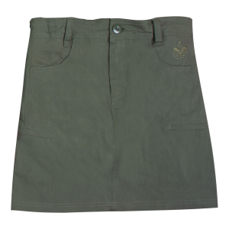
Parts to the Scouts BSA uniform
Cap: optional. Olive green or campaign hat or troop approved headgear
Neckerchiefs- optional.
Must be worn as described in guide to awards and insignia with BSA slide or handmade slide
If not worn, shirt is worn with open collar
Troop wears color as voted on
Leaders may wear bolo with open collar
Shirt: may be long or short sleeve
Forest green epaulets. Custom loops are not permitted with Scouts BSA uniform
Belt: official web belt (green) or BSA leather belt with metal BSA buckle
Footwear: BSA ankle, crew, or knee socks with neat and clean shoes
Pants/shorts/skorts: Scouts BSA shorts, convertible pants or pants w/ no cuff. Females my wear the Scouts BSA skort

Slide 66
In accordance with the provisions of the Boy Scouts of America Congressional Charter, any imitation of US Army, Navy, Air Force, or Marine Corps uniforms is prohibited
Camouflage clothing is not permitted to be worn as part of the Scout uniform.

Slide 67
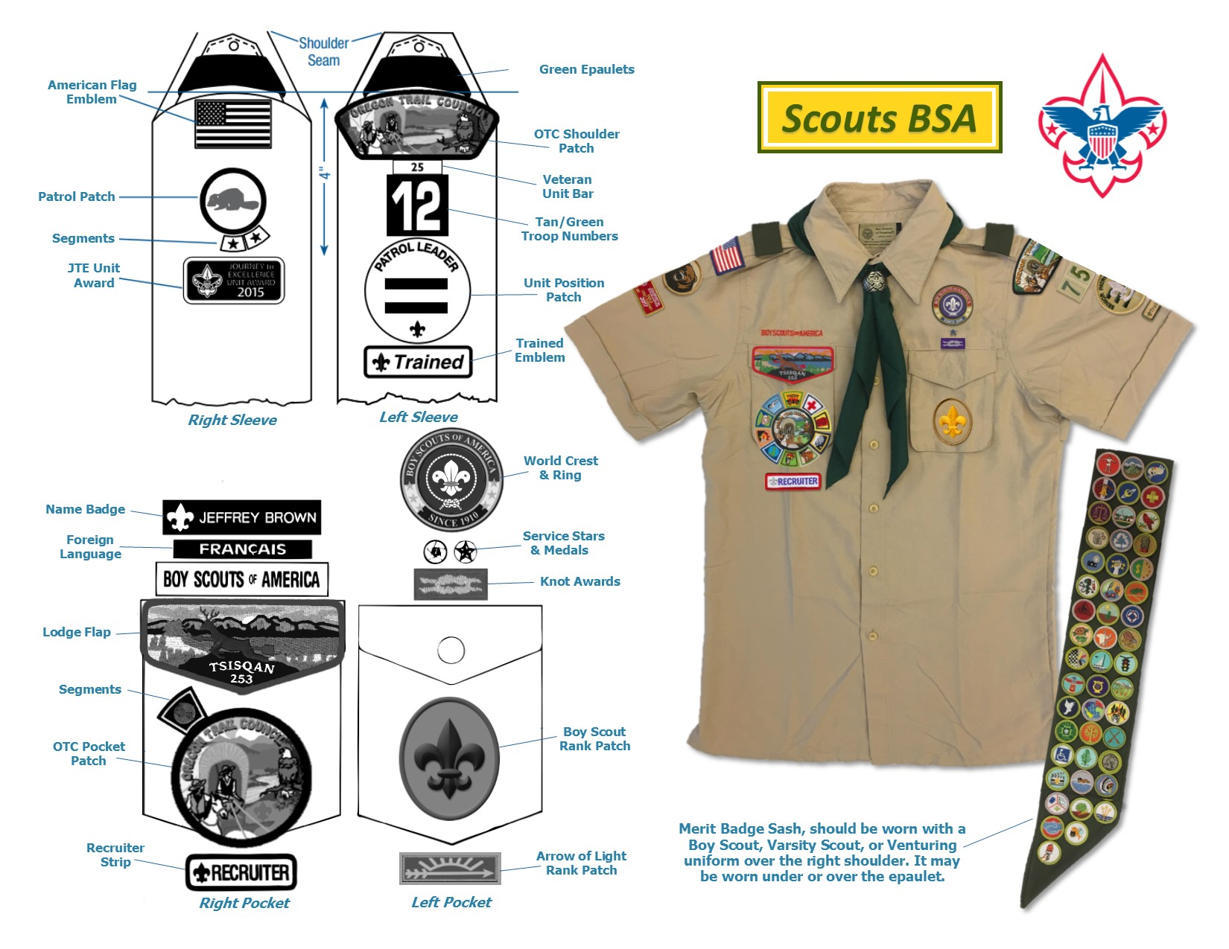
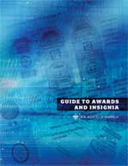
Insignia placement
For more information:

Slide 68
Wearing the uniform
Do wear:
Troop meetings
Ceremonies
Special outdoor occasions
Scouts & Scouters may take part in opening ceremonies at political events, but must leave after the ceremony is concluded to not show political endorsement
Activity shirt may be worn for physically active outdoor events and informal activities
When not to wear:
While selling a commercial product or service (may only be done with approval from Council Executive Board and under conditions consistent with the rules & regulations of Scouts BSA)
Any activity that could dishonor or discredit the BSA of the individual
Scouts and Scouters are encouraged to take part in political matters as individuals, but not while wearing their uniform

Slide 69
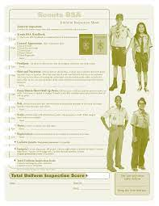
Uniform Inspections
The uniform inspection sheet is used to advise scouts and leaders how to properly wear the uniform.
Keep the Scout Oath & Scout Law
in mind when completing inspections
Remember to be Helpful, Friendly, Courteous, and Kind when attempting to correct how someone wears the uniform.
Use common sense during inspections
Basic rule is neatness
Remember the uniform is only 1 of the methods of scouting

Slide 70
Annual Troop Program Planning
The Annual Troop Program creates stability for troop, increases scout participation and allows the Scoutmaster to give youth responsibility for much of the leadership of meetings and activities
Notes:
sco_473

Slide 71
Annual Troop Program Planning
Annual program is planned 1 year in advance and shared with all families in the form of a calendar
Everyone has a role and and the plan is divided into 5 distinct steps.
Notes:
Clear plan allows all members (youth and adult) to see where they fit in and where their responsibilities lie & how they can do their part.
Planning allows troop leaders to fully employ the methods of the Scouting program and thus achieve the Aims of Scouting.

Slide 72
Planning a coherent and inviting troop program plan cannot be underestimated!
Plans may be completed yearly or every 6 months depending on whether troop elects SPL and Patrol Leaders annually or every 6 months
Notes:
Scoutmasters who help Patrol leaders plan exciting and effective meetings and activities re well on the way to maintaining the scouts’ interest and bringing them back week to week for ll Scouts BSA has to offer.
Good planning, decreases the amount of time the Scoutmaster must invest in guiding the troop. Goal is to have youth-led troops
Haphazard approach results from lack of planning and dilutes the effectiveness of Patrol and troop structure and wastes opportunities to convey the Scouting message.

Slide 73
2 types of planning
Annual long term planning:
The SPL, PLC, Scoutmaster, and other key adults involved with the troop meet once a year (or every 6 months) to determine the next 12 months (or 6 months) of troop program and major activities
Short term monthly planning:
The same troop members and leaders meet every month to fine tune the annual plan and assign Patrols & individuals tasks that will lead to success of the plan.

Slide 74
Role of the Patrol Leaders
The Patrol Leaders Conference (PLC):
Annual planning:
plans and runs the troop’s programs & activities
Gives long range direction w/ annual planning
Lays out the troop calendar
Monthly planning:
Fine tunes upcoming troop meetings & activities
Get together a few minutes after each meeting to review plans for the next meeting
Makes adjustments as needed to ensure plan’s success
The PLC, not adult leaders, is responsible for planning troop activities
Notes:
Annual planning encourages youth and adults to explore a wide range of program opportunities. Prevents the “same old, same old”

Slide 75
Role of the Senior Patrol Leader (SPL)
The SPL:
conducts meetings of the PLC where Patrol Leaders present ideas and concerns of their patrols.
Helps develop troop’s overall program
Takes PLC decision to the rest of the troop members

Slide 76
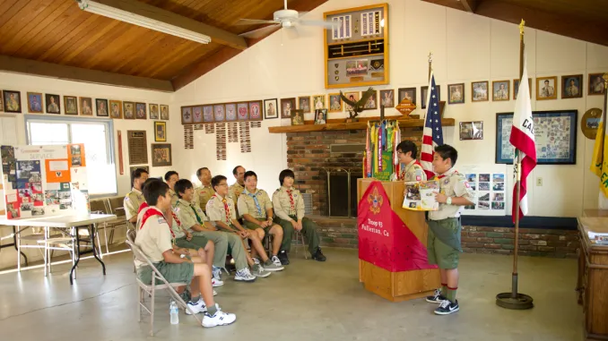
Role of Scoutmaster
Attends the PLC meetings as a coach on informational resource
As much as possible, allows Scouts to run meetings and make decisions.
Steps in with suggestions and guidance when that will enhance the program
Retains “Veto” power over decisions of PLC, but only in rare occasions when the plans of the PLC would violate BSA policy or could jeopardize safety.
Notes:
Too often troops program is planned by adults and then offered to scouts.
More effective to give scouts responsibility for selecting and carrying out troop program with adults in background providing support and coaching

Slide 77
1. Do Your
Homework
2. Get Patrol Input
3. Troop Planning Conference
4. Consult Troop Committee
5. Announce Annual Plan
Plot out calendar for other events
Evaluate past activities
Review advancement status of members for skills/activities needed
Plan should include at least 4 short term overnight campouts
Plan is driven by what Scouts want to do
SPL provides an outline with PLC, Patrol leaders present options to patrols for discussion
Patrol leaders gather feedback from patrol to prior to PLC vote
Discuss and schedule
Boards of Review
Courts of Honor
Troop Open Houses
Service Projects
AOL crossovers
Other Activities
SPL leads a final review with PLC
SPL presents to troop for approval
SPL and Scoutmaster present troop program
Committee has right of refusal
Review of plan at monthly committee meetings to discuss how to support plan.
Once approved, the plan is published and distributed to troop members, parents, troop committee, and the chartered organization representative. Be sure to include the CO building custodian
5 Steps of Annual Programming
Notes:
1.Calendar events could include: summer camp, district/council events, CO events, school related events
3. Troop planning conference: Attendees: SPL, PLC, Troop Guide, Scoutmaster, Assistant Scoutmasters, and Jr. Assistant Scoutmasters
4. Consult troop committee: if committee believes plan needs revised, the SPL will consult again w/ PLC before changes are made. Committee right of refusal should only be used if it feels the program is unsafe or otherwise unwise to pursue. The Scoutmaster may delegate parts of the plan to Assistant
Scoutmasters to provide necessary adult guidance and accountability.
5. The Annual plan serves as an effective recruitment tool with prospective scouts.

Slide 78
Journey to Excellence

Slide 79
Journey to Excellence
(JTE)
JTE is a performance and recognition program for units.
It reflects things a good unit should be doing such as:
Outdoor program
Advancement
Service
Training
Youth Leadership
Districts & Councils also have JTE standards to assist them as they work to help units and measure performance
Purpose of JTE is to help in planning and measuring units, districts, councils, and to encourage unit success.
Using JTE helps serve Scouting’s mission of serving more youth with higher quality programs
Notes:
Sco_530
Scouts and the SM pick activities they want to do nd match them with JTE Scorecard categories.
Need to plan to reach JTE goals.

Slide 80
What do you use JTE for?
Strengthen Scouting program
Used during annual program planning to identify and plan activities
Track performance
End of year assessment on troop program success and plan for next year
Notes:
JTE should be reviewed monthly and data entered to make sure troop programs are on track with the goals set.

Slide 81
JTE Scorecards and Performance Areas
Scorecard = an easy to use measure
of performance.
Standards developed by a National task force to create a balanced scorecard
The standards are re-evaluated yearly
The standards correlate to a successful, growing and sustainable program.
Performance is measured on individual and key performance indicators and overall points
Performance indicators can include:
Planning & Budget
Membership
Program
Volunteer leadership

Slide 82
JTE
Points
and
Benchmarks
Points are attached to different criteria
Overall point total and number of categories with points correlates to Bronze, Silver, or Gold JTE performance.
Goal is to help units improve performance and better serve youth within the mission of Scouting with a high quality program
JTE provides benchmarks for recognizing and rewarding units, helping everyone to improve the Scouting program

Slide 83
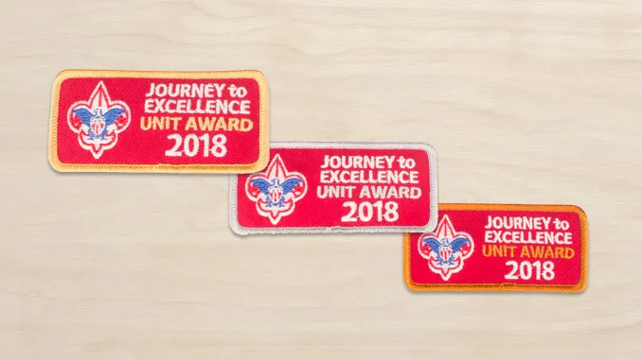
JTE Levels
Bronze = Effective performance
Silver = Excellent performance
Gold = Exceptional performance
Patches are available to wear on the scout uniform for the various levels.
There are also plaques and ribbons for unit flags

Slide 84
JTE Scorecard
The key is a strong balanced program that has the main elements of great scouting.
By completing the scorecard after each activity, you have an ongoing tracker of progress and can adjust the plan as needed to meet your troop’s goals.
The scorecard provides initiative for continuous improvement and proactive planning.
JTE is an excellent communication tool providing commissioners with information in order to provide the greatest possible help to the unit.
Available online and is used to track progress throughout the year.
Notes:
Note who their unit commissioner is

Slide 85
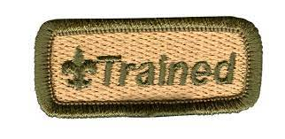
Congratulations!
You have completed Committee member & Committee Chair Training!

Slide 86
Scoutmaster Specifics

Slide 87
Scoutmaster :
works directly with the Scouts
Scoutmaster must be 21 years old
May be male or female
Appointed by Charter Organization
Trains and guides youth leaders by using Method & Aims of Scouting
Provides:
Direction
Mentoring
Coaching
Support
Notes:
#480

Slide 88
Role of Scoutmaster
Best Scoutmasters give Scouts opportunities to :
Learn,
Practice,
And Demonstrate
Good leadership
In Scout led troops- Scouts will make mistakes.
A good Scoutmaster:
Is patient
Won’t intervene to correct mistakes unless a
safety issue or violation of Scouts BSA policy
Allows Scouts to make mistakes, seek
solutions and learn from mistakes

Slide 89
Scoutmaster Responsibilities
Troop meetings: Scout led, but SM meets with Sr Leaders to make sure they have what they need. Scoutmaster minute at end of meeting
Patrol Method: SM guides SPL and Patrol Leaders. SM is responsible to make SPL successful
Outdoor Program: SM confirms the 6 steps of program planning are completed, a monthly outdoor activity planned, 1 long-term or High adventure planned annually.
Scoutmaster makes sure these are scheduled, but Scouts choose and Plan.
SM leads by example

Slide 90
Scoutmaster
Qualities:
Good Role model
Good example
Coach & Guide
Approachable
Exemplary Character
Model Citizen
Lives Scout Oath
Trustworthy
Communicates well
Helps Scouts become confident Leaders
Continues training and education after basic leader training

Slide 91
Senior Patrol Leader
Elected by scouts to serve and lead troop.

Slide 92
Role of
Senior Patrol Leader:
Leader of the Troop
Assist Scoutmaster with Troop Leadership Training
Assembles topics/materials
Appoints Leadership
Except Patrol leaders- elected by patrol
Jr. assistant Scoutmasters- appointed by Scoutmaster
Set example
Good behavior, good attendance, proper uniform, active scout, punctual, displays scout spirit, lives scout oath and scout law
Runs all meetings and events
Sets plan for Patrol Leaders Conference 1 month in advance
Prepares agenda 1 week in advance of meeting
Delegates as needed
Patrol Leaders Council Chairman
Runs meeting and assigns tasks
All other Scouts report to SPL

Slide 93
Qualities:
Elected by Youth
Age
Experience
Demonstrated Scout Spirit
Serves from one election to next
annual or may be 6 months
Scoutmaster and
Senior Patrol Leader have the same goal:
A Successful Troop

Slide 94
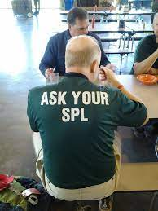
Troop Meeting:
can be a catalyst to make
adventures happen.
Glue that holds the troop together.
Opportunity
Learn new activities and skills
Put skills into action in fun and challenging ways
Exercise leadership skills
Leadership development is a method of Scouting
Scoutmaster and
Assistant Scoutmasters
are primarily for
purposes of health and safety.
Scouts that run the show take ownership of the troop
Notes:
#484

Slide 95
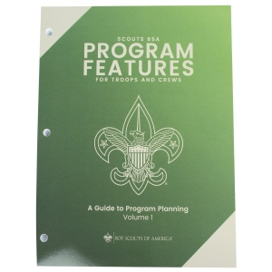
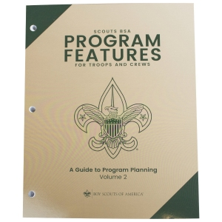
BSA resources to make successful meetings
Program Features Volumes 1, 2, & 3
48 themed modules to make program planning easier
Mix of tops: outdoor, sports, health & safety, citizenship & personal development, STEM, arts & hobbies.
Makes meetings fun and facilitates advancement
Online version available
in troop leader resources.
https://troopleader.scouting.org/program-features/

Slide 96
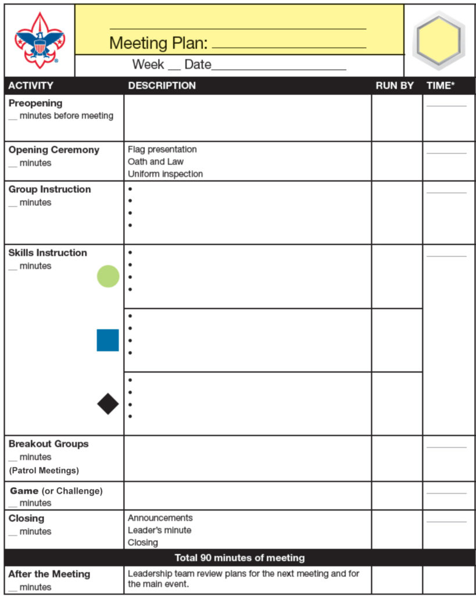
8 Parts of Troop Meeting
Opening Activity
Opening Ceremony
Group instruction
Skills instruction
Breakout Groups
Game
Closing
After the meeting
Troop meeting agenda is available in Program Features and online

Slide 97
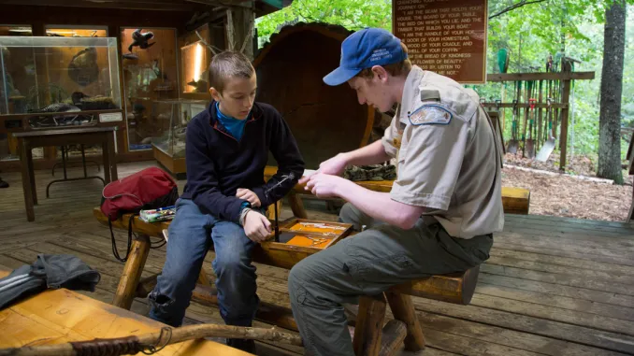
Opening Activity
Opening Ceremony
Group instruction
Skills instruction
Breakout Groups
Game
Closing
After the meeting
Opening Activity: Pre-opening activity s Scouts arrive
Should be something others can join as arriving
Opening Ceremony: Led by SPL (or selected Patrol)
5 minutes to reinforce values of scouting: Scout Oath, Scout Law, Outdoor Code, Pledge
Group Instruction: New skill, presentation, new Merit Badge can be brief or include the skills instruction time.
Skills Instruction: relevant instruction to upcoming activity
Led by well prepared scouts
Divide scouts into groups based on rank, readiness, etc
Essential
Challenge
advanced

Slide 98
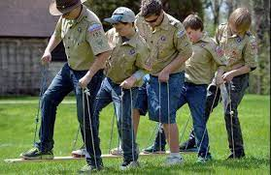
Opening Activity
Opening Ceremony
Group instruction
Skills instruction
Breakout Groups
Game
Closing
After the meeting
Breakout groups: led by Patrol leaders to conduct routine weekly business
Attendance, collect dues, plan patrol involvement in upcoming activities.
Game: Properly presented games
can provide positive outcomes
Closing: Should properly close meeting- it wraps up everything. Quiet and more serious time.
Announcements
Recognize Scouts that have earned awards
Scoutmaster Minute
After the meeting: SPL meets briefly with Patrol leaders and Scoutmaster
Review how meeting went- fine tune as needed
Praise the good and suggest/encourage for things that didn’t go well

Slide 99
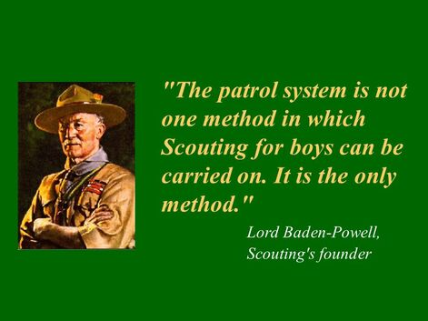
Patrol Method
“The object of the patrol method is not so much saving the Scoutmaster trouble as to give responsibility to the boy”
Lord Baden-Powell
Notes:
#478

Slide 100
Patrol Method
With Scoutmaster guidance, Scouts are formed into Patrols
BSA Troop = small democracy
PATROLS:
Building block of the Troop
Patrol Leaders are elected by the Scouts in the patrol
PL assigns tasks, and guides patrol in fulfilling assignments
Is the “family “circle”
Gives experience in group living and participative citizenship
5-8 youth close in age/experience level
Helps develop a sense of identity
Work together to share responsibility & success
Learn leadership as they follow Patrol leader’s example
Enables scouts to know what their strengths are and encourages improvement of other skills

Slide 101
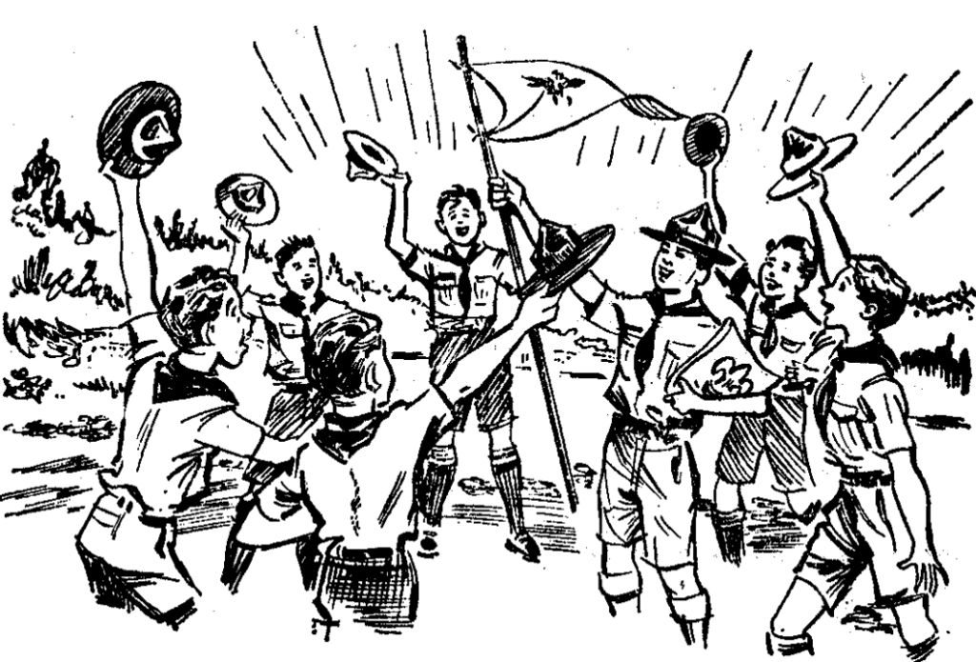
Patrol Method….
The Scouts make decisions for the Patrol:
Places responsibility and teaches youth how to accept it promoting leadership
Allows small groups so that members can easily relate to one another
Camping & Cooking together in own patrol site provides a golden opportunity to help one another, share responsibilities, and grow as a well functioning team promoting citizenship

Slide 102
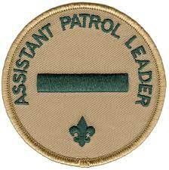
Senior Patrol Leader (SPL)
Assistant Senior Patrol Leader (ASPL)
Patrol Leader (PL)
SPL:
Elected by the troop- Runs the troop
Receives guidance and tools to succeed from the Scoutmaster
Meets with SM before & after meetings
ASPL:
Appointed by SPL
Runs troop in SPL’s absence
Helps train & supervise the troop scribe, quartermaster, instructor, librarian, webmaster, and chaplain’s aide
PL:
Elected by members of the patrol
Patrol elections allow patrol members to decide the best leader for patrol
Elections should be held regularly and treated seriously
Plans, organizes, and conducts Patrol meetings and activities
Represents patrol members at Patrol Leaders Council (PLC)
Keeps patrol informed on troop activities and deadlines
Each play a role in
the Patrol Method.

Slide 103
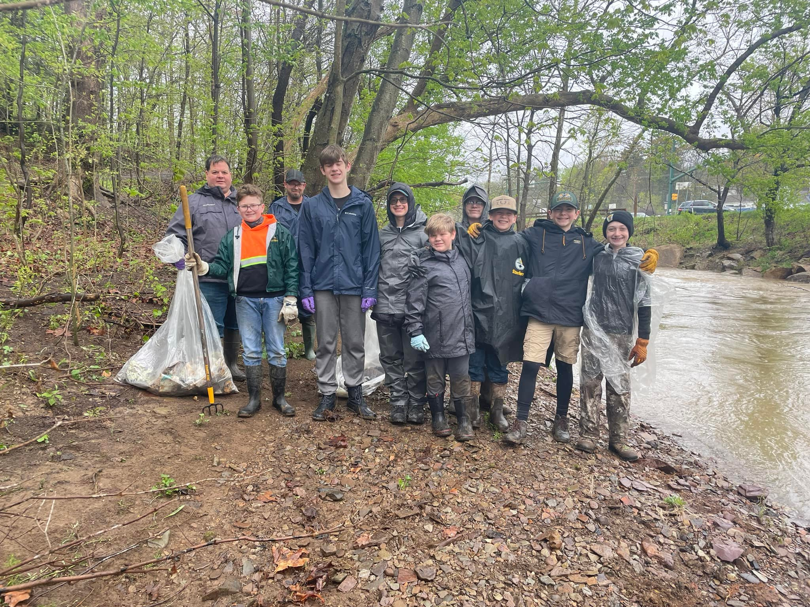
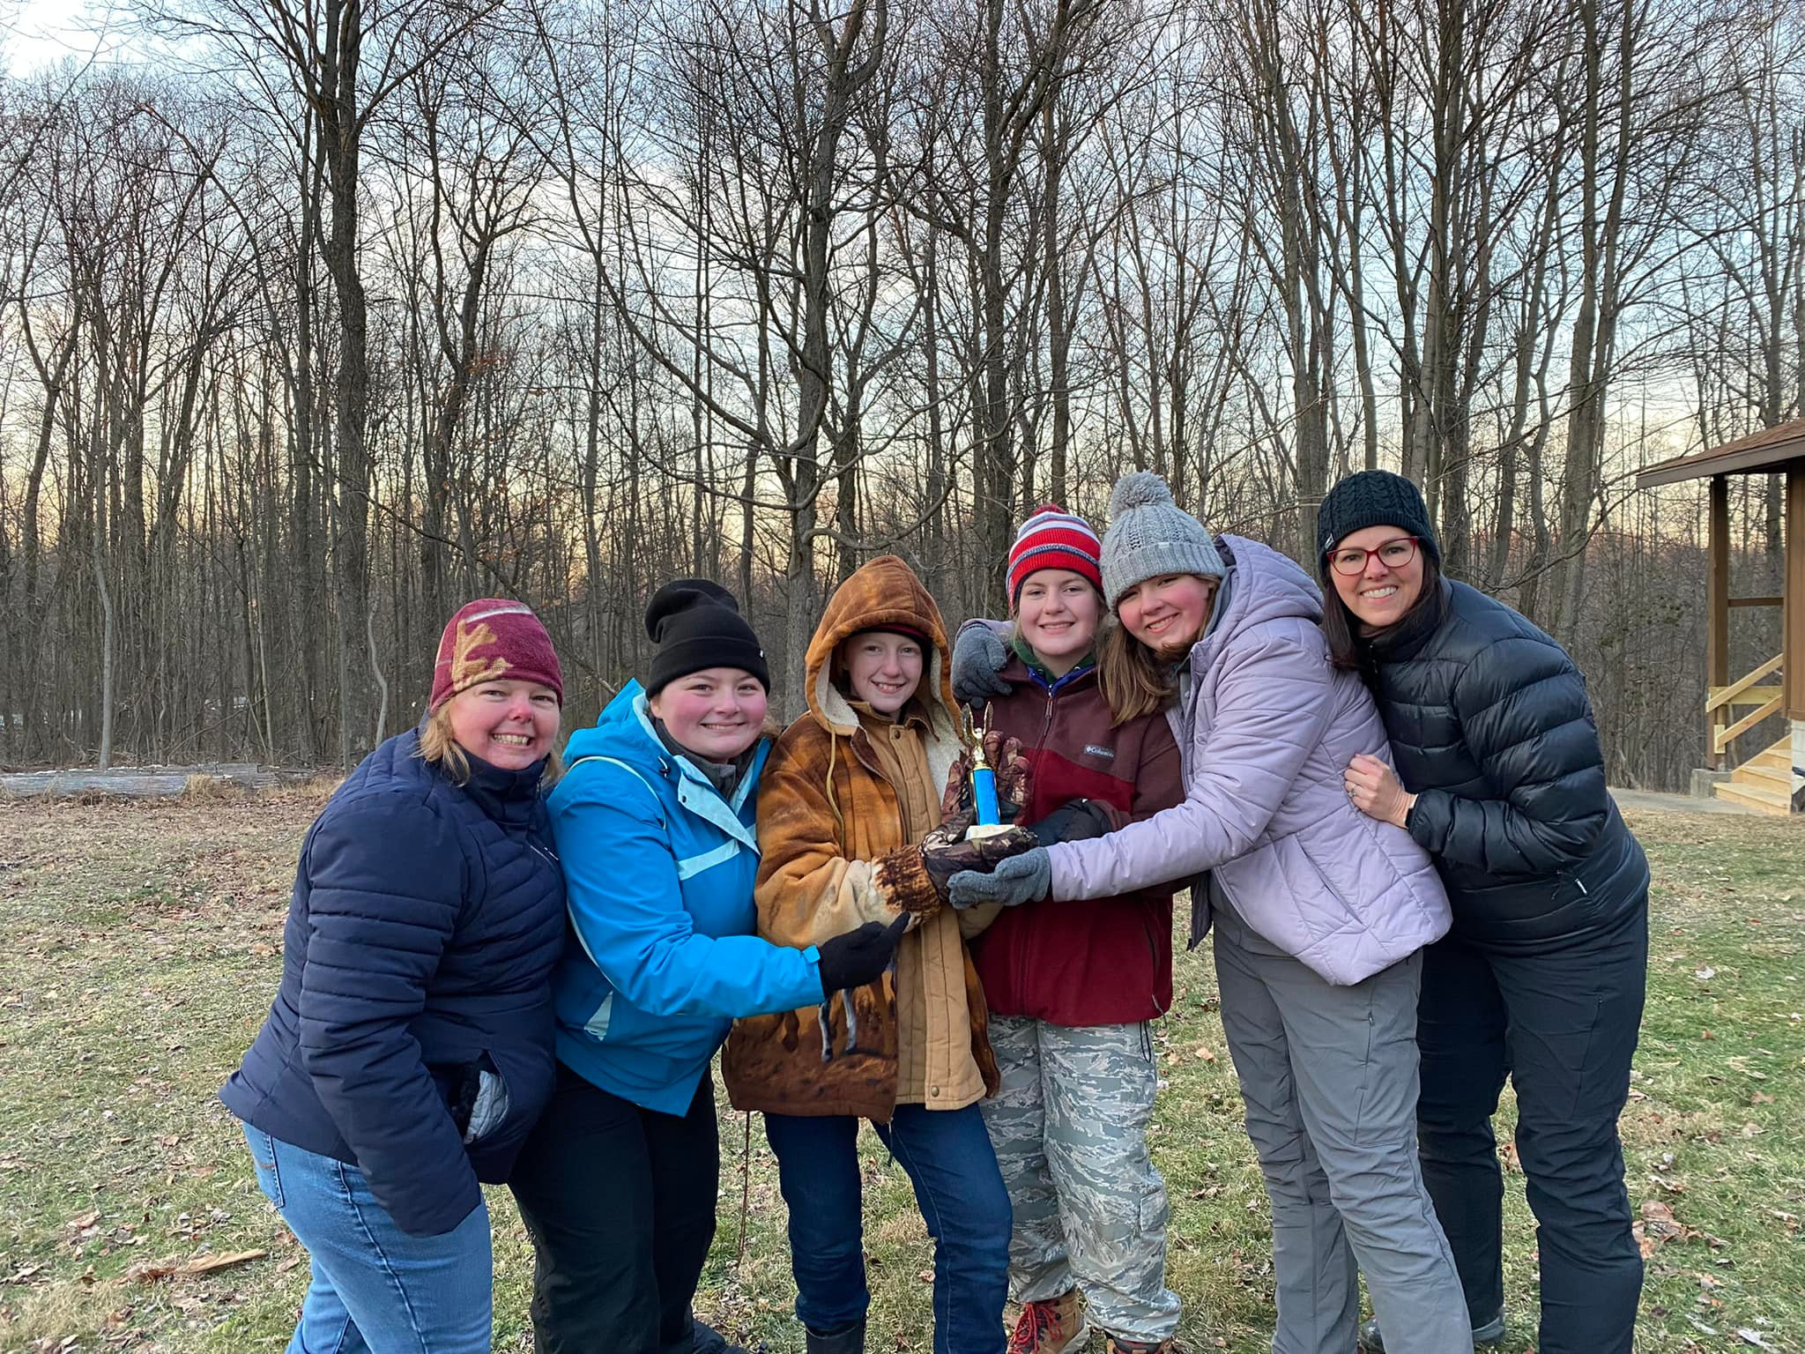
Patrols
The Patrol Leader (PL) is responsible for their patrol and each of its members
Patrols may conduct their own activities and outings with proper adult supervision
The PL Reports to their patrol what happened at PLC meetings
Plans for upcoming patrol & troop outings/menus
Designs patrol flag
builds/maintains patrol box
Work on advancements
Complete assignments for next troop meeting
Most important job of the Patrol is:
HAVE FUN!!!

Slide 104
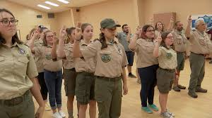
Patrols
One of the Aims of the Patrol Method is that it is actively passed down from older Scouts to younger ones.
This maintains the Patrol Method and Scout-led Troops
As seasoned scouts mentor newer scouts, the patrol method is strengthened and perpetuated
Implementing Patrol Method is ongoing to assure the patrol members have opportunities to share various responsibilities
Every Scout should have a responsibility within their patrol
SPL has responsibility to match tasks with individuals with those strengths, but the SPL doesn’t assign responsibilities within a patrol- Patrol leaders do this

Slide 105
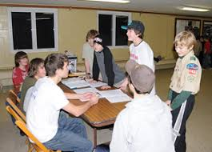
Patrol Leaders Council…
Plans and runs the troop
Through PLC, the Scoutmaster & Senior Patrol Leader teach importance of Patrol Method to Patrol leaders
SPL should understand patrol method and do their best to help troop implement it.
Patrol leaders share with other scouts in their patrol
Patrol Leaders Council meeting is important for the patrol method to work.
Patrol leaders pass what they learned to the individual patrol members
Some troops hold patrol meetings during breakout group segments of troop meeting.
*** PLC is crucial to success of Patrol System and Scout-led troops

Slide 106
Patrol Leaders Council
The PLC:
Gives long range direction with the annual planning meeting that lays out the troop calendar.
Meets monthly. Meetings lasting 60-90 minutes to make sure everything is prepared for weekly meetings.
Key youth leaders make up the PLC:
SPL, ASPL, PL, Troop Guide, Scribe.
The Scoutmaster is not part of the Council, but acts as a guide, coach, informational resource.
The scoutmaster retains veto power for any items that violate BSA policy or Safety.
Notes:
#477

Slide 107
Key members responsibilities
SPL:
Chairs and runs all meetings
Makes sure group sticks to agenda
May table items to keep things moving
Keeps PLC focused on issues of importance
ASPL:
Fills in for SPL as needed
Trains and directs QM, Scribe, Historian, Librarian, Instructors, and OA Representative
Patrol Leaders (PL):
Present ideas/concerns of their patrol
Helps plan overall program
Assistant Patrol Leader covers in PL absence
Troop Guide:
Works with new scout patrol
Teaches leader of new scout patrol troop operations and guides them through early scout activities
Scribe:
Logs meetings
Non voting member, but some troops allow voting

Slide 108
PLC:
Responsible to plan and conduct troop’s activities
In long-term- PLC deeply involved in planning troop’s program at the annual program planning conference and carrying out monthly meetings activities.
In Short-term- plans and conducts troop activities. At conclusion of troop meeting and as needed the PLC meets informally to review success and review responsibilities for future meetings and events.
Presents yearly plan to troop committee for approval, provides feedback at the end of each meeting/activity and helps the SPL put effective leadership methods into practice

Slide 109
PLC Meeting Agenda:
Opening and call to order
Roll Call and Reading of minutes
Patrol reports
Old Business
Main event planning
Troop meeting planning
New Business
Scoutmaster minute

Slide 110
At conclusion of PLC:
Youth leaders should understand the plan for meetings and events
PL should be clear on information to be shared with their patrols.
SPL will check with Patrol Leaders ongoing to make sure they are on top of the plan.
SM and SPL will review agendas prior to meetings to make sure everything is ready to go

Slide 111
Scouts and Outdoor Ethics go hand in hand
Plan an outdoor program that emphasizes practicing:
Outdoor Code
Principles of Leave No Trace
Principles of Tread Lightly!
Principles of Land Ethic
Outdoor Ethics guide leadership position for Star, Life, and Eagle
OUTDOOR ETHICS
Notes:
#475

Slide 112
Scout Law
Outdoor Code
Leave No Trace
Tread Lightly!
Land Ethic
Courteous
Clean
Clean in outdoor manners
Dispose of waste properly
Leave what you find
Sportsmanship
Trustworthy
Thrifty
Careful with fire
Minimize campfire impact
Perception
Husbandry
Friendly
Courteous
Kind
Considerate of the outdoors
Leave what you find
Respect Wildlife
Be considerate of other visitors
Respect rights of others
Avoid Sensitive Areas
Perception
Sportsmanship
Helpful
Thrifty
Reverent
Conservation Minded
Plan ahead & prepare
Travel & Camp on durable surfaces
Educate yourself
Avoid sensitive areas
Do your part
Husbandry
Land Ethic
All Aspects of Outdoor Ethics is related to Scout Law in some way

Slide 113
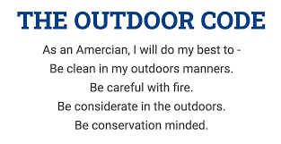

Slide 114
Leave No Trace
Principles of Leave No Trace
Plan and Prepare
Minimize damage to natural resources
Observe regulations
Pack in and pack out
Leave what you find
Minimize campfire use
Respect wildlife
Respect property

Slide 115
Tread Lightly!

Slide 117
Land Ethic: Aldo Leopold
Reflects the existence of an ecological conscience
… this in turn reflects a conviction of individual responsibility for the health of the land.
Health is the capacity of the land for self-renewal.
Conservation is our effort to understand and preserve this capacity.
A thing is right when it tends to preserve the integrity, stability, and beauty of the biotic community
It is wrong when it tends otherwise.
Aldo Leopold, A Sand County Almanac

Slide 118
Congratulations!
You have completed Scoutmaster & Assistant Scoutmaster Training!

